Slide 1
NMAP
Jen Beveridge and Joe Kolenda

Slide 3
History of NMAP
secret.pathetic.net
Developed by Gordon Lyon
Features
Host discovery
Port scanning
Version detecting
OS detection
Scriptable interaction with the target

Slide 4
Uses of NMAP
Identifying open ports
Network Mapping
Auditing security

Slide 5
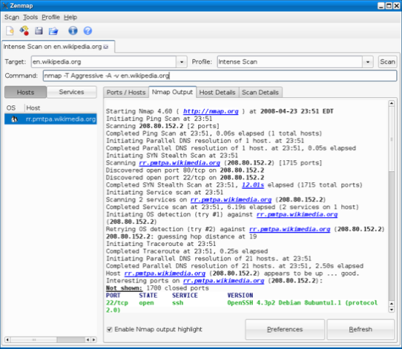
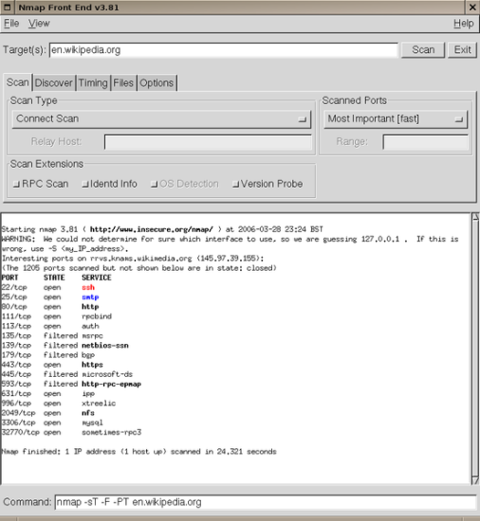
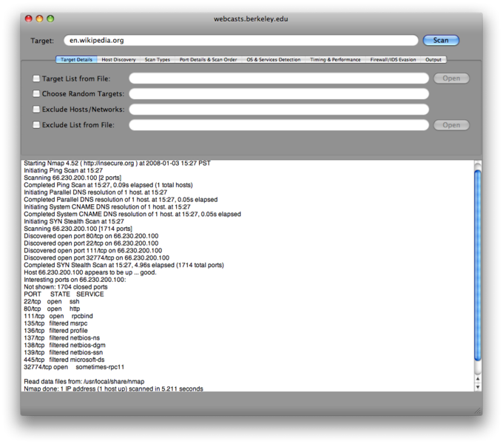
Tool Environment
Runs on Linux, Windows, Mac OS X and other smaller operating systems
GUI options:
Zenmap
XNMap
NmapFE

Slide 6
How It Works
DNS lookup- matches name with IP
NMap pings the remote target with 0 byte packets to each port
If packets are not received back, port is open
If packets are received, port is closed
Sends different packets with different timing to determine filtered/unfiltered, version, etc.
Firewalls can interfere with this process

Slide 7
Output from NMAP
Displays open ports
Different output based upon constraints on run, but can show
Version type
Filtered/unfiltered

Slide 8
Basic NMAP scans
When run through command prompt or terminal, entry fields are:
Program
Constraints on run
Target
Ex. > nmap –sS scanme.nmap.org
Ex. > nmap -Db ftp.pathetic.net secret.pathetic.net

Slide 9
User Experience
Easy to install
Fairly easy to use, firewall problems and network setting issues
User guide available, many tutorials
Scan time- can range from a few seconds to several hours
Can scan over a range of IP addresses and utilize stealthy scanning

Slide 10
Ethical Issues
Can be used for hacking- to discover vulnerable ports
System admins can use it to check that systems meet security standards
Unauthorized use of Nmap on a system could be illegal. Make sure you have permission before using this tool

